Slide 1
Telecare and Assistive Technology Awareness Trevor Thompson Learning & Development Consultant

Slide 2
Group Learning Agreement Points
Respect
Listen to each other
One person speaking at a time please
Issues of confidentiality
Please be punctual
Challenge constructively the views not the person
Minors/school

Slide 3
Contract/House keeping
Fire
Toilets
Primley House
Mobile phones
Breaks

Slide 4
Introductions
First Name
Job Role
Experience with telecare

Slide 5
Objectives
An introduction to:
Gain an understanding of what Telecare and Assistive technology means
Be aware of what types of telecare equipment are available and understand how they work
Have taken a simulation tour around a house to see how telecare equipment is used practically
Be aware of the community alarms service

Slide 6
Warm up Exercise
“In groups consider all the assistive technologies which exist in your home, draw up a list with your team”.

Slide 7
Tele…
7

Slide 8
Tele is Ancient Greek meaning -“far off”

Slide 9
Assistive Technology
“Any product or service designed to enable independence for disabled and older people”

Slide 10
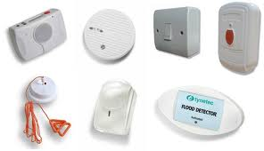
Telecare
…is characterised by continuous, automatic and remote monitoring to manage the risks associated with independent living. Examples include medication dispenser, temperature extreme monitors & smoke alarms.
10

Slide 11
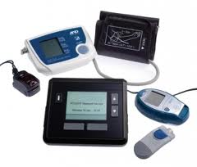
Telehealth
…is the remote exchange of data between an individual and a health care professional and aims to assist in the diagnosis and management of health care conditions.
11

Slide 12
King’s Fund
The King's Fund is an independent charity working to improve health and health care in England. We help to shape policy and practice through research and analysis; develop individuals, teams and organisations; promote understanding of the health and social care system; and bring people together to learn, share knowledge and debate......
12

Slide 13
Telecare operates across the operating model and facilitates the flow to the left in that people moving to the left of the customer pathway are reabled
13

Slide 14
Historical Model Telecare
Residential Care
Personal Assistant
Luncheon Clubs
Supported Accommodation
Voluntary Services
Home Care
Day Care
Telecare

Slide 15
New Model Telecare
Telecare
Residential Care
Day Care
Personal Assistant
Home Care

Slide 16
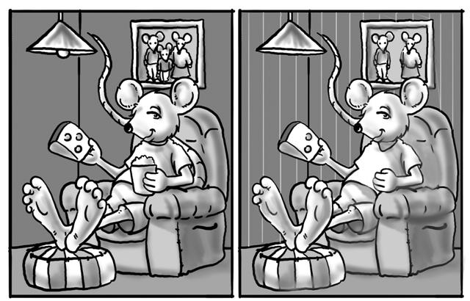
Spot the Difference

Slide 17
UK Population
Office for National Statistics (ONC) Census 2011 England Wales: 56.1 million + North Ireland 1.8 million , ONC October 2011, Population Projection 2027 to reach 70 million.

Slide 18
Walsall Population
Simcox 2012, Older people commissioning strategy from the joint commission unit NHS Walsall and Walsall council

Slide 19
Age Band | 2012 | As % of total 65 plus population
People aged 65-69 | 13,500 | 29%
People aged 70-74 | 11,300 | 24%
People aged 75-79 | 9,200 | 20%
People aged 80-84 | 6,800 | 15%
People aged 85-89 | 3,800 | 8%
People aged 90 and over | 2,100 | 4%
Total population 65 and over | 46,700 | 100%
It is estimated for 2012 there are approximately 46, 700 people 65 & over in Walsall accounting for around 18% of Walsall's total population.
The majority of people within the 65 plus age band are aged between 65-69 (29%) & 70-74 (24%).
Simcox . T, 2012 Older people analysis, housing services

Slide 20
Projecting Walsall Population
Total Population as % | 2012 | 2015 | 2020 | 2025 | 2030
Total population | 260,300 | 264,600 | 271,800 | 278,500 | 284,700
Population aged 65 and over | 46,700 | 48,600 | 50,700 | 53,400 | 58,000
Population aged 85 and over | 5,900 | 6,600 | 7,800 | 9,300 | 10,800
Population aged 65 and over as a proportion of the total population | 17.94% | 18.37% | 18.65% | 19.17% | 20.37%
Population aged 85 and over as a proportion of the total population | 2.27% | 2.49% | 2.87% | 3.34% | 3.79%
As at 2015 people over 65 will account for 18.37% of the boroughs population & 20.37% by 2030.
Simcox . T, 2012 Older people analysis, housing services

Slide 21
What are the issues people come to you for?
21

Slide 22
People with....
Learning disabilities
Age related conditions
Long term health needs
Physical & sensory disabilities
22

Slide 23
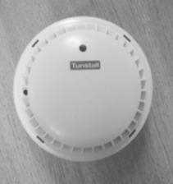
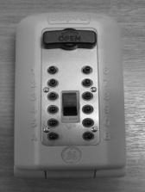
Telecare Equipment
23

Slide 24
Telecare Equipment
Basic Safety Package : an alarm and pendant, Smoke alarm and police approved key safe
The package is offered to all new service users.
Existing service users can upgrade to this package if required.
24

Slide 25
Fall Detector

Slide 26
Fall Detector
- ideal for people who are prone to falls and would be unable to raise an alarm themselves due to capacity issues or a certain medical condition such as, epilepsy.

Slide 27
iVi ‘The Intelligent Pendant’
What is it
The iVi has been designed to operate as an intelligent pendant. It provides the standard function of an help button with the addition of automatic fall detection technology.
Notes:
Ivi = ivee

Slide 28
How it works
The fall detection algorithm is designed to make use of changes in barometric pressure, acceleration and static orientation in order to assess whether a fall event has taken place. How quick it drops or stops/acceleration.
When the iVi detects an event which is assessed to be like a fall (up to 20 seconds) then it will alert the user by emitting tones from the sounder and lighting the green LED. The user then has 10 seconds to cancel the alert by pressing the cancel button.
The iVi can also assess whether it is being worn. The period before this raises an alarm is configurable (3, 5 or 7 days). This feature is turned off by default and only turned on in advanced mode.

Slide 29
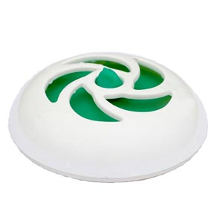
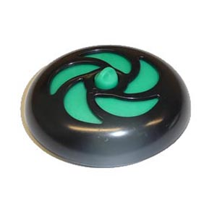
Magi Plug
29

Slide 30
Magi Plug
- Magi Plug For Baths is a really useful and simple way of preventing your bath from overflowing. It's Bath Plug with a difference, as it contains a pressure sensitive spring which knows when the water rises above 15 Inches ( 38cm ) and simply opens to let the water out.
30

Slide 31
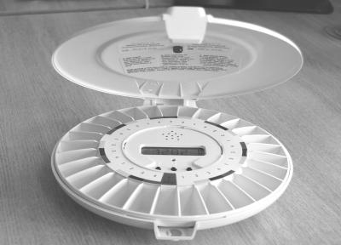
Pill Dispenser

Slide 32
Pill Dispenser
- to remind the individual to take a pill. The dispenser can be linked to an alarm or works independently as a reminder.

Slide 33
What it can’t do
Stop falls
Make people take their medication
Replace humans
33

Slide 34
Primley House Virtual Tour
http://webwalsall.com/primley-house/

Slide 35
Other Assistive Technology
Item | Supplier | Cost Per Unit
Mobility Aid Swivel Cushion | Argos | £19.99
Medical Poly Stocking Aid | Argos | £8.99
Elastic Shoe Laces | Argos | £14.99
Kettle Tipper | Argos | £18.99
Can/Jar Opener | Argos | £24.99
Remote Controlled Mains Sockets | Maplins | £29.99
Motion Detector Lights | B&Q | £12.98
SenCit Care Monitoring Device | SenCit | £207.00
Fingerprint Recognition Door Handle | Delany Secure | £234.00

Slide 36
Other Assistive Technology
Dementia Day/Night Clock | Claremont Plc | £27.50
Reminder Pill Box | Nottingham Rehab Supplies (NRS) | £14.95
Memo Minder | NRS | £32.99
Plate Surround | NRS | £4.00
Dycem Non Slip Mat | NRS | £25.00
Plastazote Tubing 1 ¼ “ | NRS | £5.50
Border Patrol Safety Beam | NRS | £40.00
Memory + Amplified Telephone | NRS | £70.00
Magiplug | Byretec | £7.14
GPRS Location Device | Curry’s/PC World | £179.99

Slide 37
Gadget Gateway Link
http://www.gadgetgateway.org.uk/index.php/?___store=walsall

Slide 38
Telecare every day life link
http://everyday-life.co.uk/

Slide 39
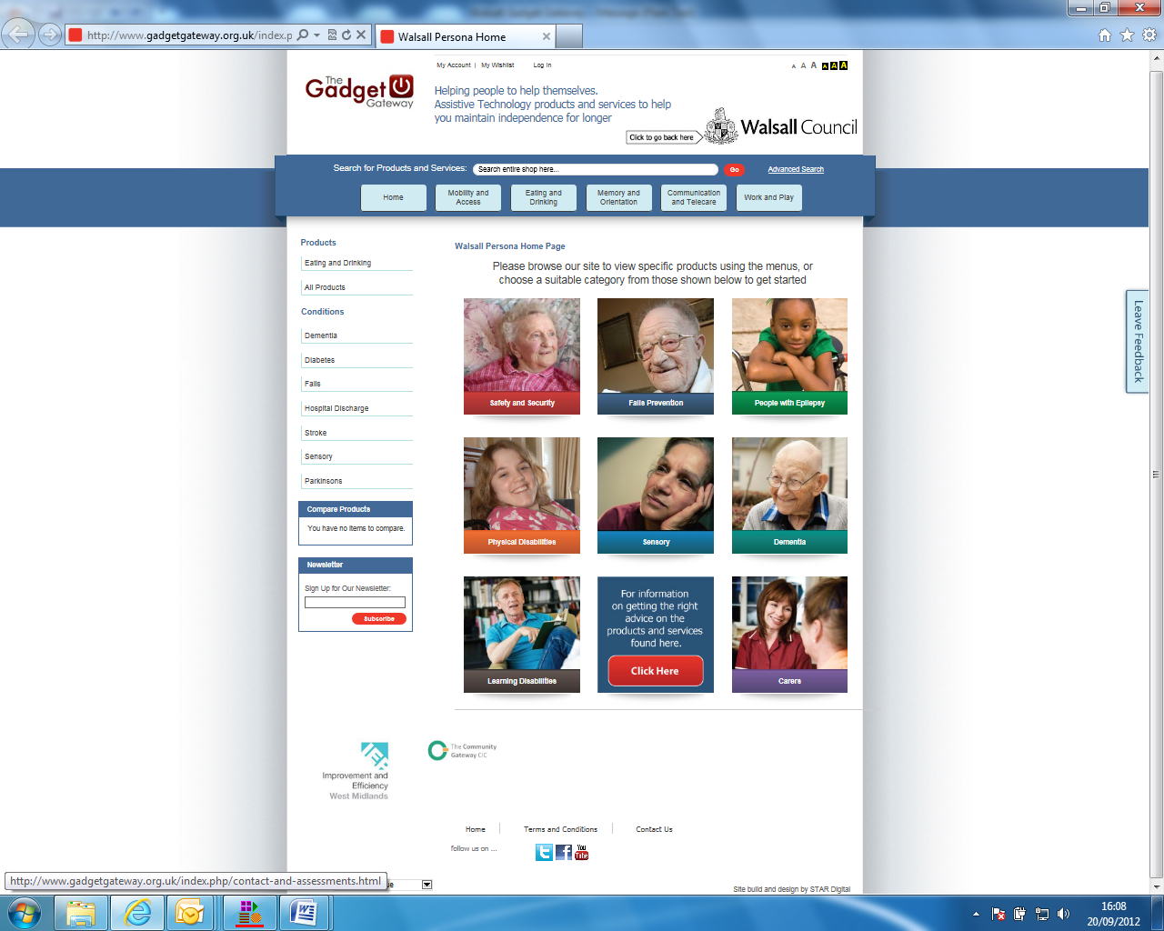

Slide 40
Take a Break

Slide 41
Case Study 1
Mrs Smith is an 83 year old female that has lived alone for a number of years since her husband died, she has a small circle of friends and family that check on her periodically, however she values her independence and is very protective of her home life.
She has various medical problems that are controlled by tablets, her eyesight and mobility is reasonable however she has fallen on a couple of occasions when getting up at night, and although she was not injured she was unable to get herself up.
Her Daughter is concerned that when she has visited her mother she had failed to take her medication, also in the event of something going wrong she was worried if her mother would be able to take the appropriate action.

Slide 42
Possible Telecare Solutions
A lifeline and pendant was fitted with the following equipment:
2 flood detectors
2 Smoke alarms
Carbon Monoxide detector
Bogus Caller
Bed sensor
Lamp modules
Medical dispenser
Key Safe
(Impact on individual, carers, care package)

Slide 43
Case Study 1
How would you promote telecare to a service user/reluctant service user ?

Slide 44
Case Study 2
Mr Brown is a 58 year old male that lives at home with his daughter and son in-law. He is in good health but has recently been diagnosed with the early onset of dementia. The family are concerned about his safety when they are at work, they have arrived home from work on occasions and the neighbours have informed them that Mr Brown had been seen confused in the street and unsure where he was going, and the neighbours had bought him back home.
Mr Brown’s daughter was also concerned because on one occasion he had turned the tap on in the bathroom and left it running, luckily he had not put the plug in.

Slide 45
Possible Telecare Solution
A lifeline and pendant was fitted with the following equipment:
2 flood detectors
2 Smoke alarms
Temperature Extreme Sensor
Property Exit Sensor
Key Safe
(Impact on individual, carers, care package)

Slide 46
How to make a Referral ???

Slide 47
Telecare Referral Form
http://www2.walsall.gov.uk/eforms/ufsmain?esessionid=BFB5C44D4EEE8E9F0FCF740B15CEAC19_1&formid=ADULT_TELECARE_REFERRAL

Slide 48
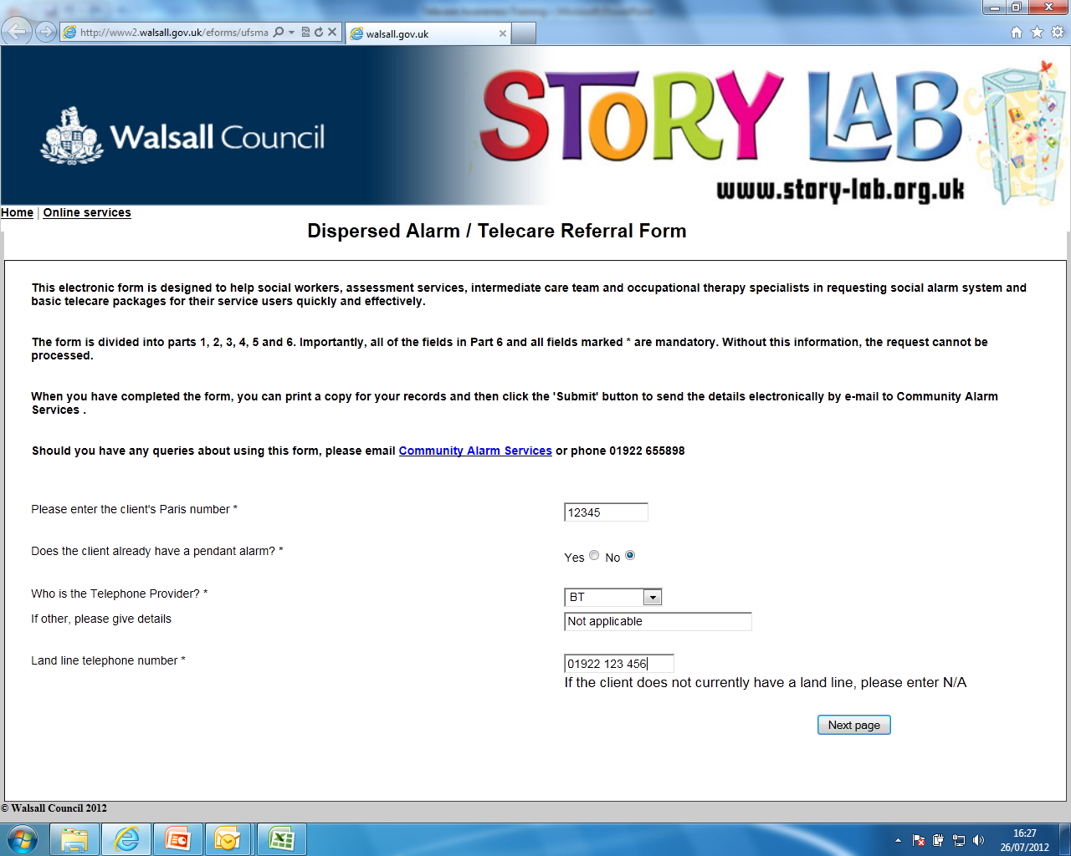

Slide 50
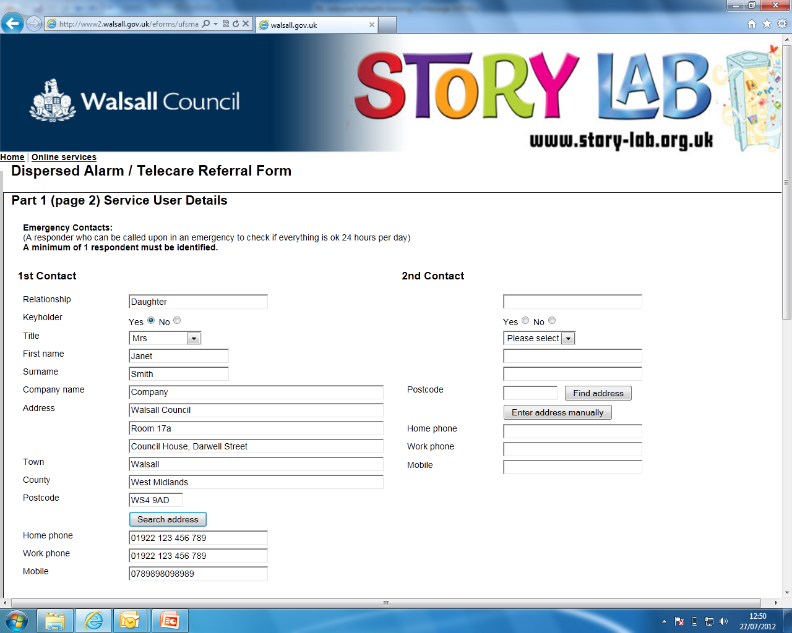

Slide 51
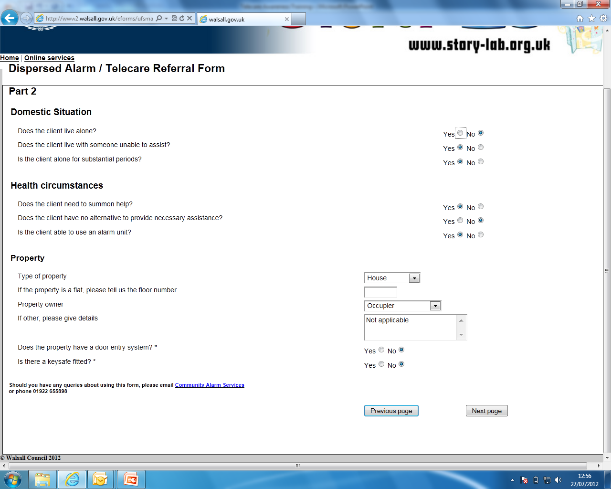

Slide 52
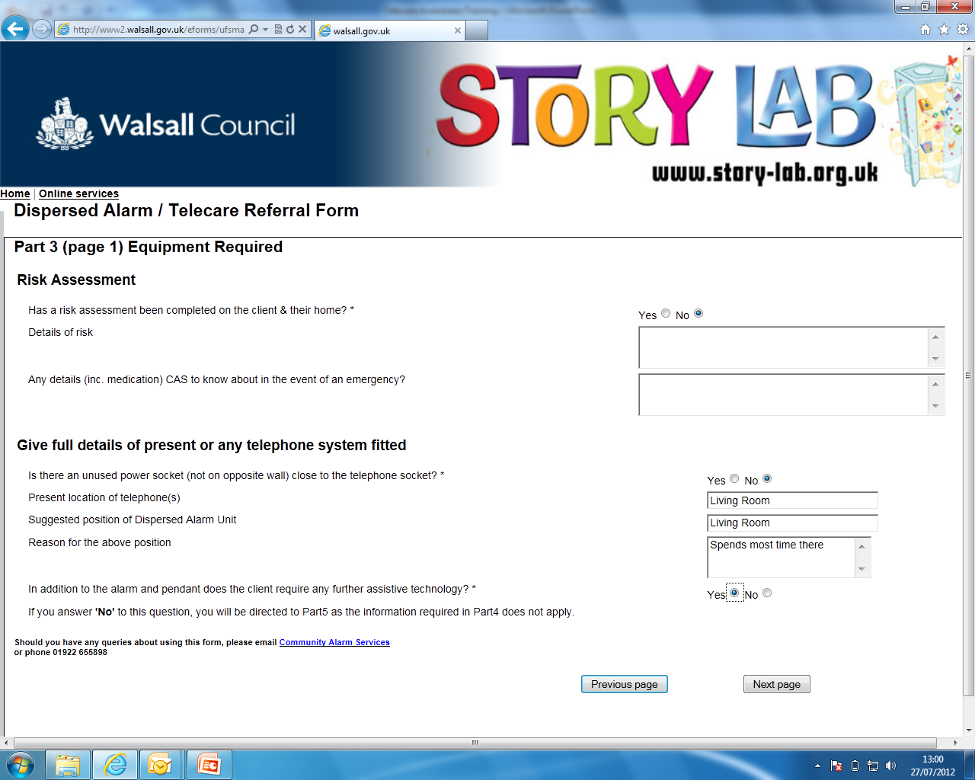

Slide 53
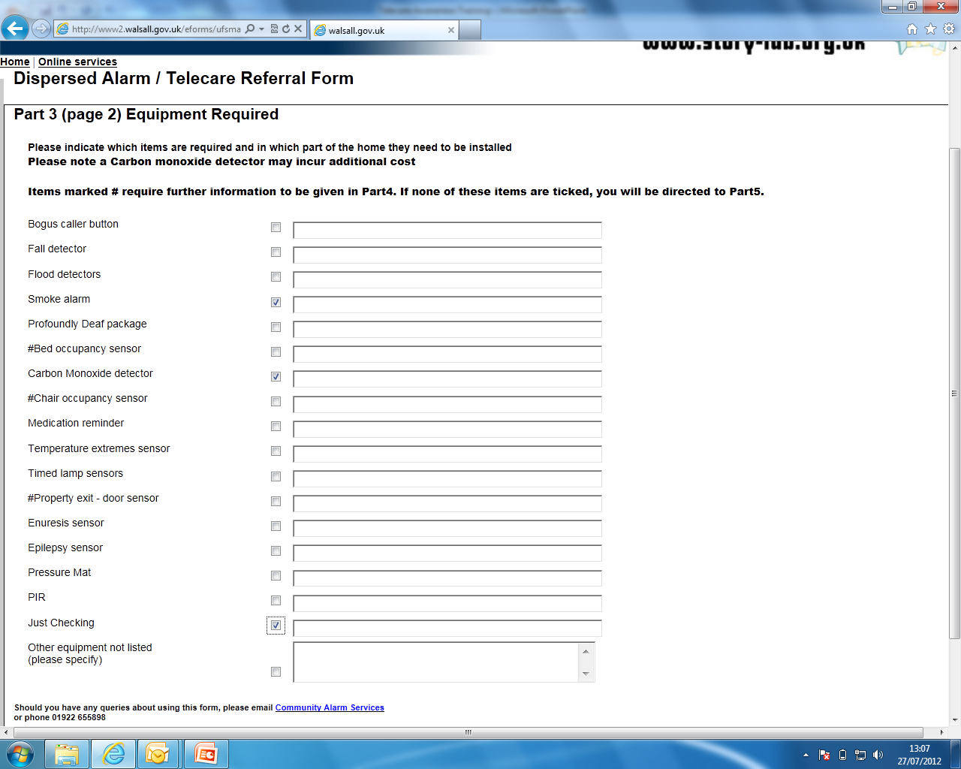

Slide 54
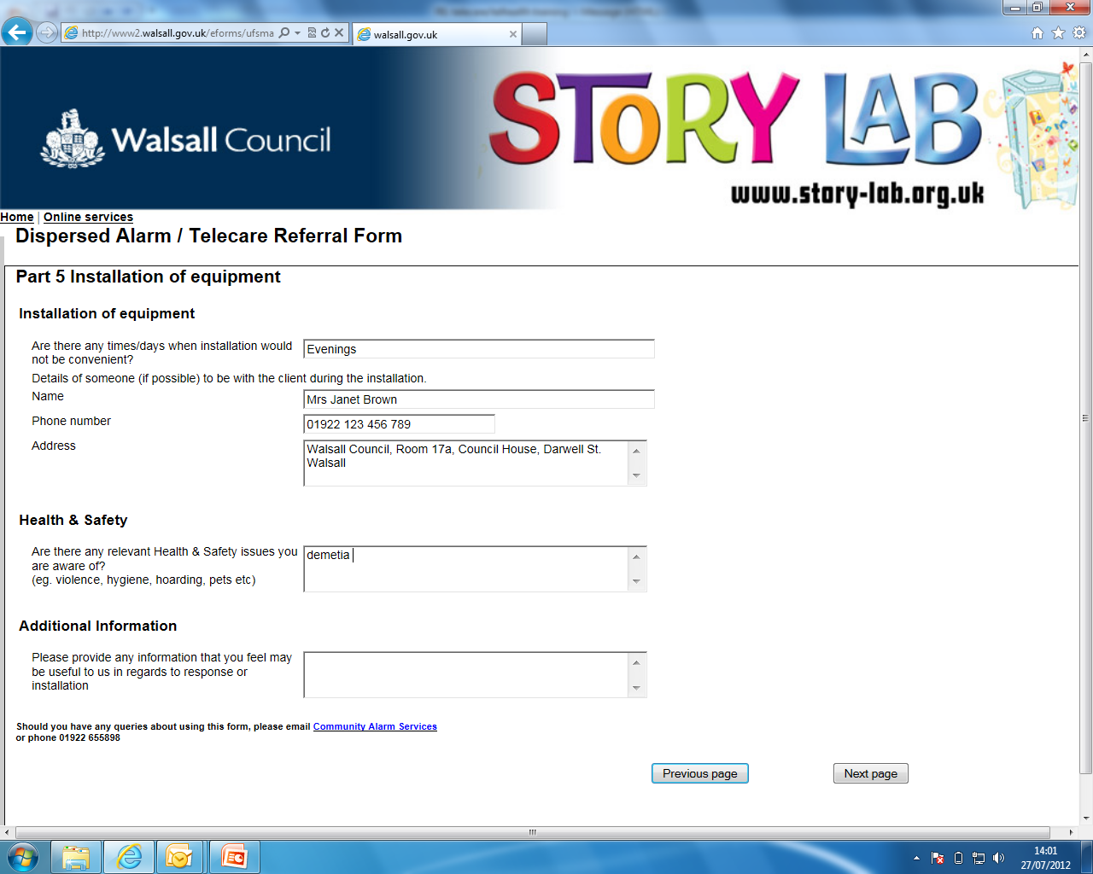

Slide 55
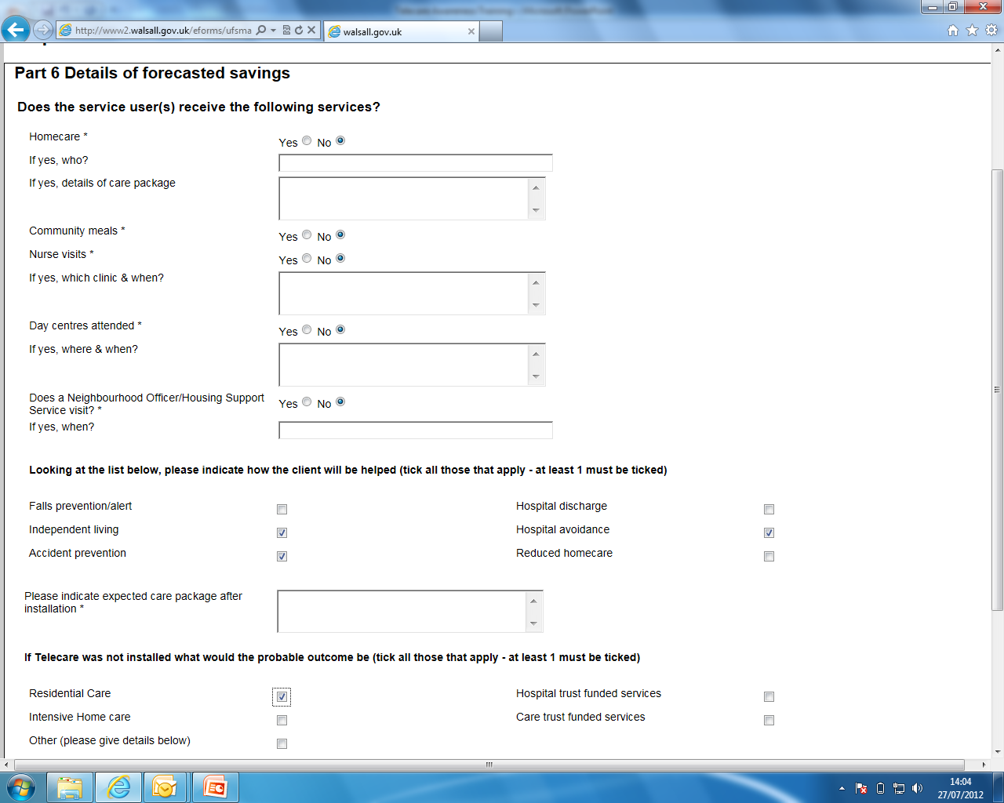

Slide 56
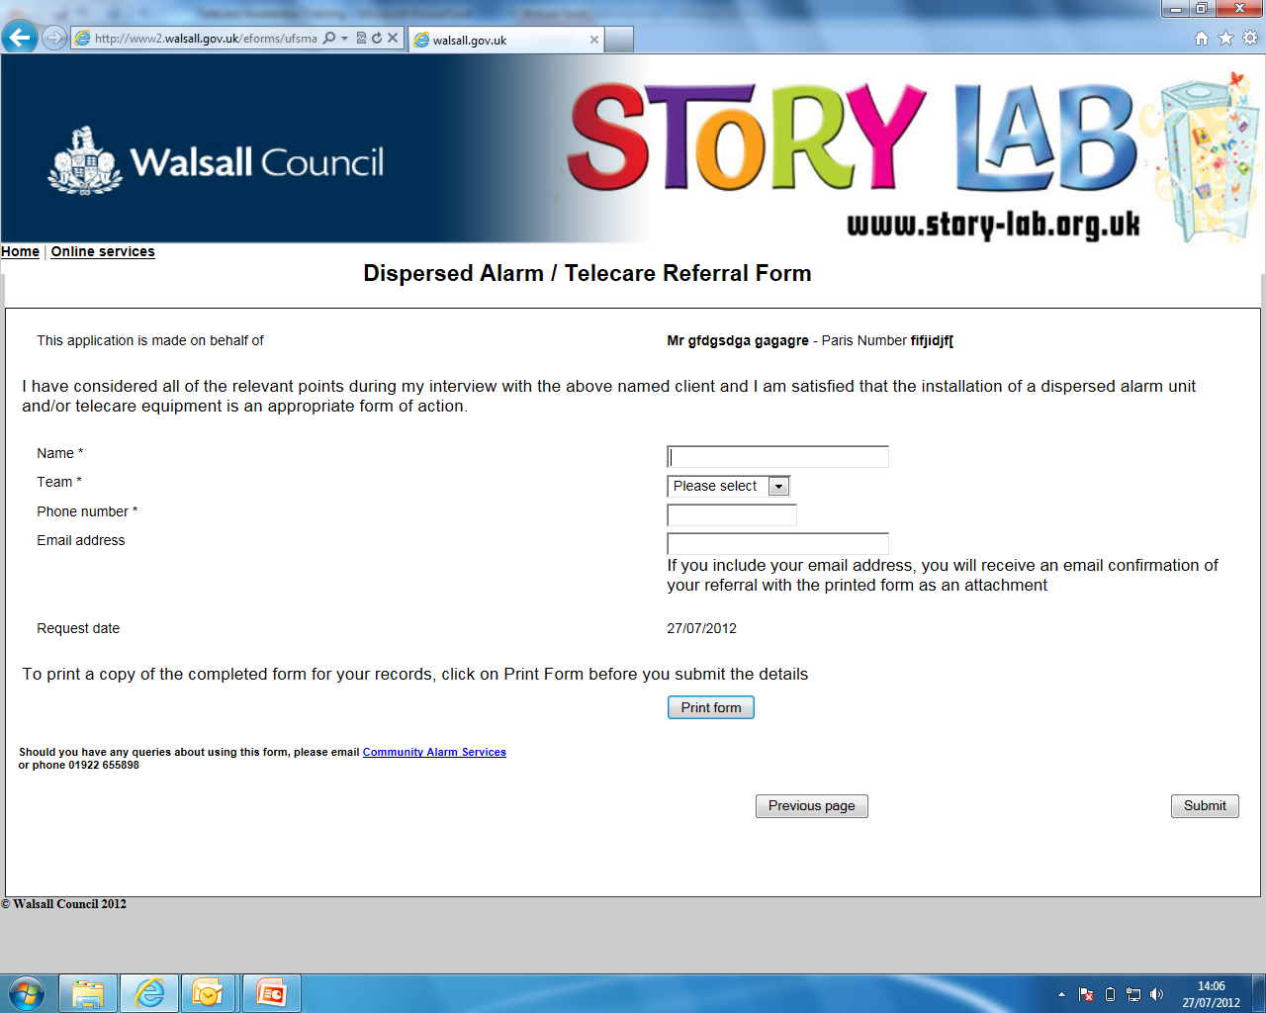

Slide 57
Charges & Time Frame
Charge of £12.50 per month or £150 annual fee (charge is for the monitoring & response)
Citizens 80 years and above service is free of charge
Aim to fit within 7 days but this dependant on whether we can make contact to arrange installation appointments
Fit same/next day for urgent referrals (e.g. hospital discharge)
All other equipment requests are dealt with ASAP, normally taking 2 weeks to obtain equipment and arrange installation

Slide 58
Exemption Charges

Slide 59
Contacts/Referrals

Slide 60
Quiz Time

Slide 61
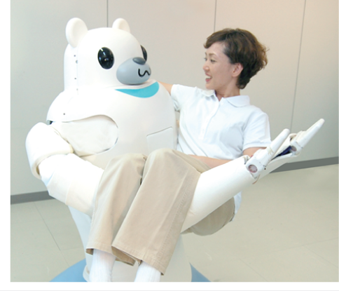
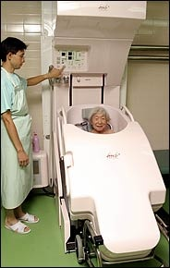
The future?
RIBA (Robot for Interactive Body Assistance). RIBA is the first robot that can lift up or set down a real human from or to a bed or wheelchair.
Japanese bathing system for older people
Notes:
Thank Kevin Doughty for this slide

Slide 62
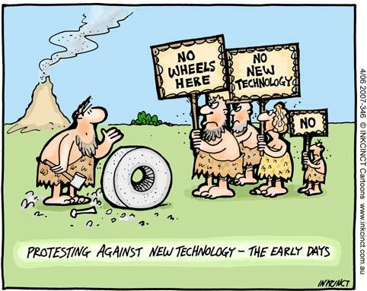
62

Slide 63
63

Slide 64
Evaluation

Slide 65
Telecare and Assistive Technology Awareness Trevor Thompson Workforce Development Team

