Slide 1
Advanced Assistive Technology Training Trevor Thompson Learning & Development Consultant

Slide 2
Group Learning Agreement Points
Respect
Listen to each other
One person speaking at a time please
Issues of confidentiality
Please be punctual
Challenge constructively the views not the person

Slide 3
Contract/House keeping
Fire
Toilets
Mobile phones
Breaks

Slide 4
Introductions
First Name
Job Role
Achieve from today's learning

Slide 5
Aim & Objectives
Increase awareness of: advanced assistive technology
the purpose of rem pods in dementia care including the reason why they have been developed and potential advantages
the role of I pads for people with dementia and potential advantages
the role and purpose of location devices for individuals who are prone to wandering and the challenges to adopting these systems
the role and purpose of face-time apps, pen friends and ‘dragon software’ for people with sensory loss

Slide 6
Introduction (note. advanced assistive technology can be used to support people with a variety of conditions- initially we will consider dementia & sensory loss). 800,000 people have dementia in the United Kingdom Set to rise to 1 million by 2021 and 1.7 million by 2050 17,000 are under 65, (although this figure may be up to x3 higher) 1 in 3 over 65s will die with dementia 3200 people with dementia in Walsall (2013 figures - Alzheimer’s Society)
Background

Slide 7
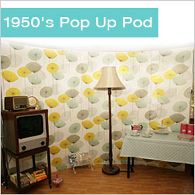
What is a Rempod
RemPods
Are pop up Reminiscence Pods (RemPods), which can help to improve quality of life for people with dementia living in a care setting. The RemPods are pop up reminiscence rooms and work by turning any care setting into a therapeutic, calming environment. There is no need to have a dedicated reminiscence area as this may take up permanent space and be comparatively rarely used . You can just pop up/down the Rempods when needed. All Rempods help to relieve boredom and work as a meaningful 'fun' activity, most importantly they build better care bonds between staff and their residents and potentially help to raise care standards.

Slide 8
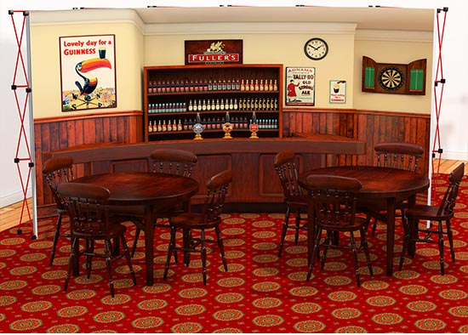
Reminiscence Pods
Pop up Pub

Slide 9
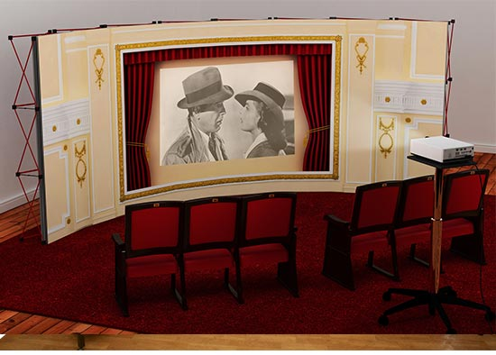
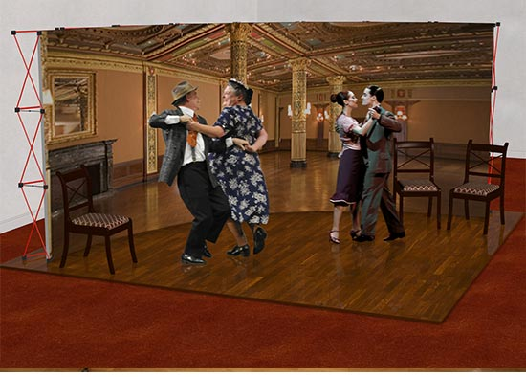
Reminiscence Pods
Pop up Cinema
Pop up Dance Hall

Slide 10
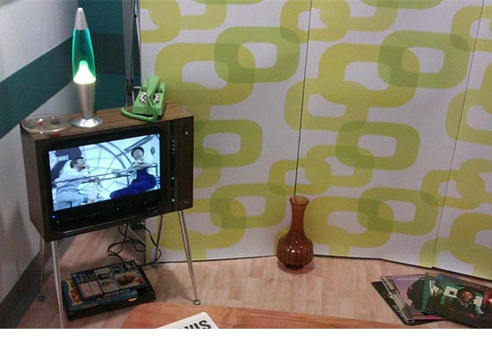
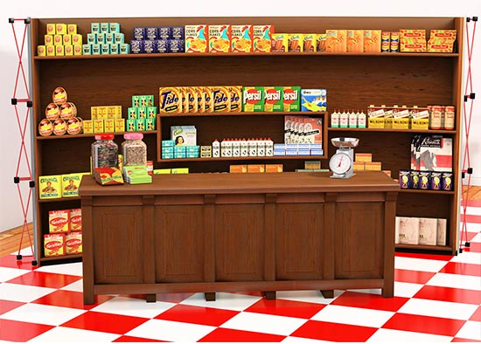
Reminiscence Pods
1970’s Pop up Living Room
Vintage Pop up Store

Slide 11
Rempod videos
University Hospital North Staffordshire
Elderly Care Reminiscence hub
http://www.youtube.com/watch?v=QBPvzCGw6Ng
http://www.youtube.com/watch?v=PF88lcbZwVY

Slide 12
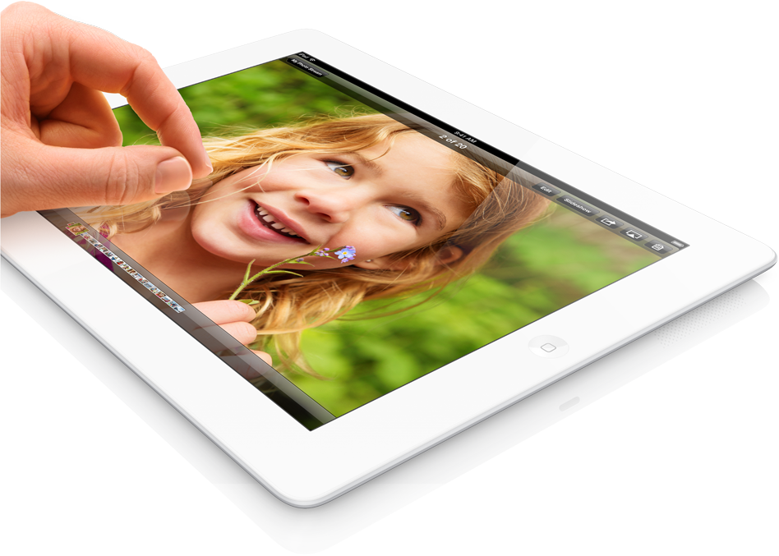
I pads
Definition
The I Pad is a tablet computer developed by Apple. It is smaller than a typical laptop, but significantly larger than the average smart phone.
The I Pad does not include a keyboard or a track pad, but instead has a touch screen interface, which is used to control the device.
http://www.techterms.com/definition/ipad

Slide 13
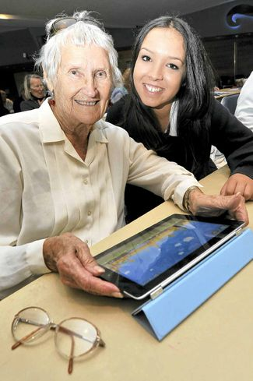
I Pad Benefits/facts
For people with dementia within care home settings/own home
Increased interaction within the care homes
Females enjoyed more group activity
Males used the I Pads for longer periods
Younger family members visited more and joined in
Provoked memories and emotions
Residents aware of more interaction
Staff reported getting to know residents better
Staff reported that it prompted conversation
Staff reported residents having access to new things
It is something residents have control of
Improved relationships
New learning!

Slide 14
I Pad Challenges
For people with dementia within care home settings/own homes
Challenges of using touch screen technology
Corporate issues related to problems getting Wi-Fi access
Staff confidence in their own technological skills
Complexity of the interface for unsupported individual use of the I pad.
The weight of the device, and problem seeing the screen because of its reflective surface

Slide 15
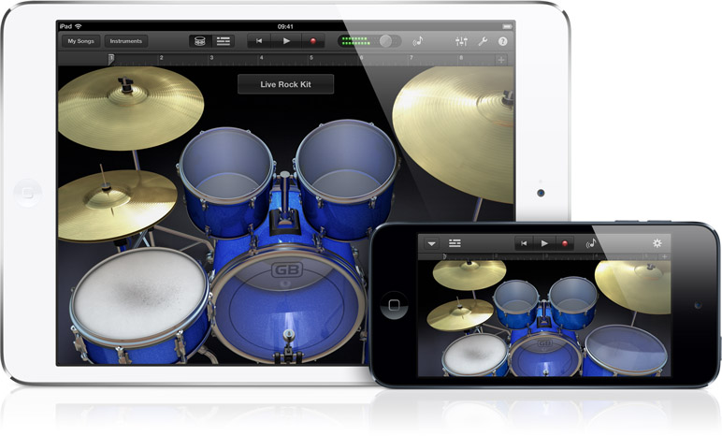
I Pad Apps
Definition: Apps is an abbreviation for application. An app is a piece of software. It can run on the Internet, on your computer, or on your phone or other electronic device.

Slide 16
Face Time app
Could be used for people who use British Sign Language (BSL) as a means of communication with each other where ever they are. Hard of hearing/deaf
Tap FaceTime to make a video call. FaceTime closes the distance between you and family from miles to inches. To make a video call, tap FaceTime. Then select a name of the person you wish to talk to, wait for the person to accept the call. The FaceTime works over Wi-Fi or mobile networks, so you can effectively wave hello from anywhere.

Slide 17
Face Time app
You can switch between cameras during a call.
On the front of your iPad is a FaceTime HD camera. On the back is an iSight camera. You can switch between them anytime during a call. So your family & friends can see you, or the next minute they can see what you are seing.

Slide 18
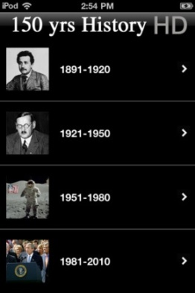
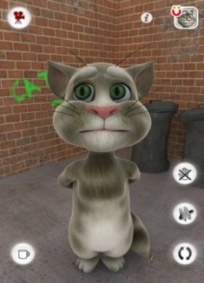
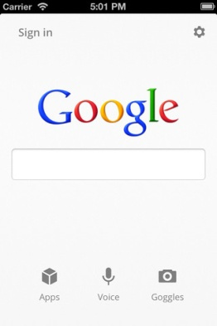
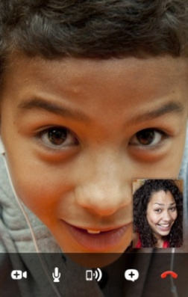
App Demonstration

Slide 19
App Prices
Free
£0.99
£6.99
£13.99
£69.99

Slide 20
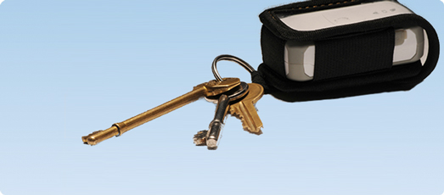
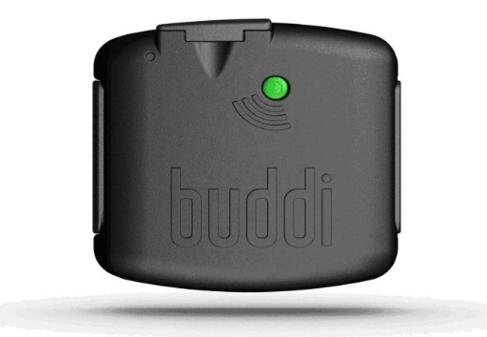
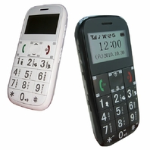
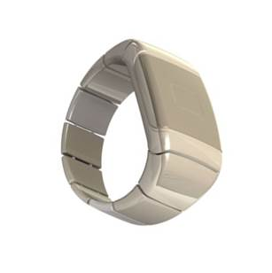
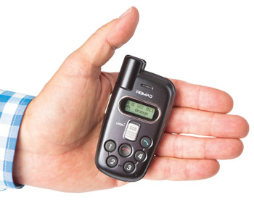
Location Devices

Slide 21
Location Devices
Key features
Location finder
Push button emergency alarm
Automatic fall alert
24/7 emergency monitoring

Slide 22
Location Device Case Study Mark Bolton is a 58 year old gentleman with moderate learning disabilities; he lives on his own in a two bed room ground floor flat, he has worked as care takers assistant in a local school for eight hours per week and worked in a office environment doing basic tasks such as shredding. Other than that Mark has little experience of working and holding down a job long term as his learning disability has prevented him from doing so. Mark’s challenging behaviour has increasingly become worse. He regularly runs away to distant places and cannot be found, he would leave his home deliberately during any hours of the day or night without informing anyone of his intentions and then become lost. When this happens his carers would go around the local community with pictures of him to try and locate him, often people would think they were police officers. This caused his family and carers a great deal of anxiety and stress as well as risk for his safety as he was familiar with local routes but not other routes. Short of following him around the only other option was to report him missing to the police. It became apparent that as you were increasing the hours of support so Mark could be monitored by staff in order to keep him safe. This was undesirable as Mark did not want people around him all the time, he felt oppressed and it became costly to the local authority. The local authority then identified that they could use the tracking device linked to his mobile phone so that if he did leave his home Mark could be found quickly and safely. As you were able to reduce the support hours and he was able to continue to live in the community without alarming his careers or family. The device proved to be very helpful to Mark, helping to maintain his independence and dignity.
Case Study 1

Slide 23
Location Devices
What are the advantages to location devices?
2. What are the disadvantages to location devices?
3. What are the risks associated with location devices?
Notes:
1 Balance between independence and safety
2Wandering in not harmful when done in safe environment, healthy outlet for person with dementia
3No device or system can guarantee that a person with dementia will get lost of found. But may keep them safer
4 Consider the benefits drawbacks and safety needs
5 Early discussions with family members or caregivers to have discussion as part of planning for the future
6 Location devices personal freedom and safety, give family members more peace of mind? Others may feel it is an invasion of privacy

Slide 24
Case Study 2
Mr. & Mrs. Martin
Mr. Martin lives in a house with his wife Debbie, a retired school teacher, Mr. Martin is 75 years old and his wife who is 72 years old have been married for 51 years and have lived in the same community most of their lives. The married couple are settled and happy. However, Mrs. Martin has developed dementia and as a result, began wandering during the night and visits to shopping centres. On occasions the police have picked her up and brought her home and security staff have had to intervene using tannoy announcements in shopping centres. All of which has resulted in a great deal of anxiety for Mr. Martin as well as risk to her safety.
Notes:
Would not know how to use the device
Wife would be treated like a criminal
How would we afford such a device
You will need to convince/reasure him it is a good idea

Slide 25
Case Study 2
‘Delegates /Learners’
You have recommended a smart phone tracker however, Mr. Martin is uncertain about this.
In your groups what would be his possible objections/worries
2. How would you respond to his objections/worries
Notes:
Would not know how to use the device
Wife would be treated like a criminal
How would we afford such a device
You will need to convince/reasure him it is a good idea

Slide 26
Royal National Institute Blind(RNIB) Pen Friend
RNIB Pen Friend Audio Labeller
RNIB PenFriend - Is a voice labeller. This device enables you to record your own self adhesive voice label on a wide range of items around the house, at school or at work. It can be used to label food items, freezer food and includes "use by dates" and cooking instructions. When you’re doing your shopping, you could label items as they are placed into your shopping basket or add labels to your film and music collections. You can place notes on medicine packaging and organise your paperwork.

Slide 27
Royal National Institute Blind (RNIB) Pen Friend
RNIB Pen friend demonstration
http://www.youtube.com/watch?v=ePE0-U73Ajc

Slide 28
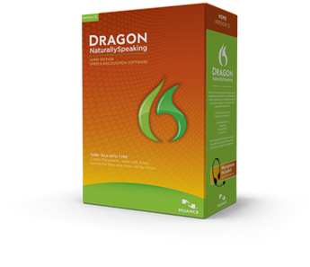
Dragon Speech Recognition
What is it
Speech recognition software for adults and children
Who can use it
Can be used by individuals with for example dyslexia, rheumatoid arthritis, attention deficient disorder, quadriplegic or other injuries
What does it do
When the spoken word is expressed via a head set it types the narrative, completes files documents, Word, Excel, Power Point, Face Book and Twitter,
Languages
English, French, Italian, Dutch, German and Spanish, 97-99% accurate,
Intuitive.

Slide 29
Dragon Speech Recognition
Dragon Demonstration videos
http://www.nuance.com/for-individuals/by-product/dragon-for-pc/home-version/index.htm#dr_pc_demo

Slide 30
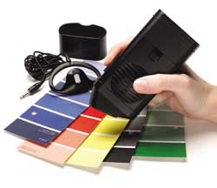
Colour Detector
Cobolt talking colour detecto
Compact product fitting s easily into your hand.
It is a battery operated able to identify 12 colours.
Hold the detector to an item of clothing, it will speak the colour in a clear male English voice.
Can detect the variations in colour, such as light, very light, dark and very dark or combination of colours
• Basic colours are as follows; white, grey, black, purple, blue, green, yellow, orange, red, pink, brown and olive green
• Can be used on a variety of surfaces; paper, cloth, wood, plastic
• Three volume levels
• Headphones
Costs in the region of £66.00 (with VAT)

Slide 31
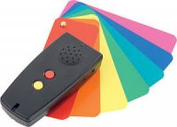
Colour Detector
Colorino talking colour detecto
Compactly designed to fit your hands comfortably
Battery operated colour detector with light detector function
Detects up to 150 colours.
By holding the detector to an item of clothing, it will speak the colour in a clear male English voice.
Product details
• detects including shade variations
• choose from three volume levels
• Portal for earphones
Price in the region £160 (including vat)

Slide 32
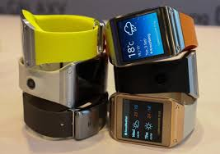
Smart Watches
Functions not dissimilar to smart phones
Time
Phone calls
Apps
Music
Face book
Messaging
Photo
Video
Pedometer
Email
Text
Part phone/part tablet ‘phablet’
Different colure straps
Disadvantages
Poor battery life,
Some have to be linked to mobile phone

Slide 33
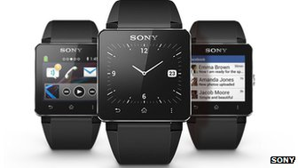
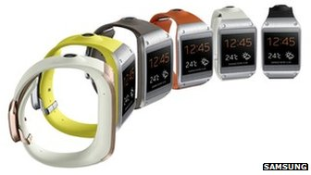
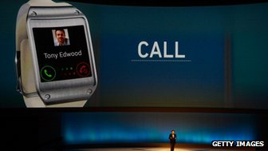
Smart Watches

Slide 34
The Future?
Video/Interactive television

Slide 35
iVi ‘The Intelligent Pendant’
What is it
The iVi has been designed to operate as an intelligent pendant. It provides the standard function of an help button with the addition of automatic fall detection technology.
Notes:
Ivi = ivee

Slide 36
How it works
The fall detection algorithm is designed to make use of changes in barometric pressure, acceleration and static orientation in order to assess whether a fall event has taken place. How quick it drops or stops acceleration.
When the iVi detects an event which is assessed to be like a fall (up to 20 seconds) then it will alert the user by emitting tones from the sounder and lighting the green LED. The user then has 10 seconds to cancel the alert by pressing the cancel button.
The iVi can also assess whether it is being worn. The period before this raises an alarm is configurable (3, 5 or 7 days). This feature is turned off by default and only turned on in advanced mode.

Slide 37
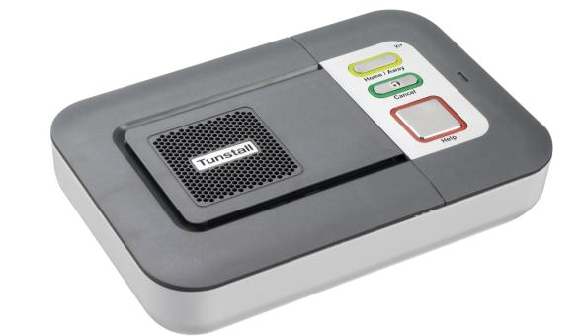
Lifeline IVI
Integral ambient temperature sensor with programmable high and low alerts
Removable speaker cover for cleaning
Embossed cancel button for visually impaired
Improved battery back up – 40 hours
Contemporary light pipe feature on buttons
Improved speech/ voice quality with automatic gain control
Automated regular personal trigger test reminder
Table stand or easy wall mount options. Available Winter 2012
Portable installer keypad/ID card with micro USB Available Winter 2012
75% cheaper to run – power saving with new power adaptor

Slide 38
Features of Lifeline Vi+
Ability to connect 35 sensors to this base unit
Will identify individual sensors
Ability to Call sequencing to carers/family/friends/call centre
Dial Completely silent dialling (domestic violence/dementia)
Auto low battery (radio triggers)
Notes:
This makes a Connect Lifeline in a home so much more than just a pendant alarm.
35 sensors would probably be used for more than one person but the unit is intelligent enough to identify who, what and where and forward that info on.
Call sequencing allows choice of responders but be aware it could delay time of response on the hunt group.
Prompts – meds reminders Critical visits – nurses, end of life care ….. Tell the audience about yellow and green button features on the next slide.

Slide 39
Quiz Time

Slide 40
Acknowledgements Julie Bride Stacey Senior Chris Evans Sally Dowding Sue Lloyd

Slide 41
Evaluation

