Slide 1
Promoting Independence and Delivering Efficiency
Telecare:
minimising the risk of your investment
Nathan Downing
nathan@tcgcic.org.uk / 07970 567332

Slide 2
Continuing trend of investment in Telecare
On-going investment in Telecare – investing in resources long term
Over a third of local authorities have invested portion of section 256 funding on Telecare
WSD / DALLAS - large scale rollout programmes haven’t been the big driver in promoting Telecare to Councils; hard evidence and best practice from peers has
Large investment from manufacturers / telecoms companies – greater marketing towards over 55’s than younger age groups

Slide 3
Unsustainable demand on social care?
By 2030 in West Midlands:
+ 415,000 over 65’s (+45%)
+ 167,000 over 65 living alone (+50%)
+ 50,000 with dementia (+75%)
+ 11,000 per year admitted to hospital with a fall (+50%)
Telecare/AT is the critical success factor in addressing this demand
Multi-agency approach is needed – social care have led on Telecare, it can play a wider role for partners
www.poppi.org.uk version 6.0

Slide 4
AT can be an integral element of every step of the customer journey
Information/
Advice/
Guidance
Rapid Response
Assessment
Care
& Support
Delivery
Review
Reassessment
Re-ablement/
Further Assessment
Assessment RAS
Support Planning
Brokerage
1st Contact/ Screening
SDS Operating Model
(an example)
Telecare/AT has a key role to play throughout every element
Slide extracted from a presentation “Personalisation in Social Care Services, by Jeff Jerome at the National Homecare Council’s conference, Oct. 2008
Notes:
4

Slide 5
Strengths of West Midlands resources
Telehealthcare Network – well established and leading edge with contributions from majority of Councils, and involvement from Health
Innovations group – challenges manufacturers, presents service user feedback and influences product development
Both groups now expanded to include representation from East Midlands & South West
Regional investment and collaboration – JIP/ADASS funded projects - £800k+ efficiencies realised from £45k investment across 5 projects
Councils currently collating good practice examples of realising efficiencies
Shared learning through ADASS funded Dementia / AT project
Strong Telecare leads, highly regarded around the country

Slide 6
Bringing down the cost of existing care packages using Telecare (local/regional evidence) – In every instance ask ‘Why not Telecare?’
LD reassessment – examples from Sandwell (following slide) with independent sector provision and Wolverhampton with inhouse services - http://www.westmidlandsiep.gov.uk/index.php?page=816
Dementia/LD – use of GPS technology to encourage safer walking and independence, and to support carers – appendix example from Gloucestershire (A)
Hospital discharge/reablement – example from Dudley - http://www.westmidlandsiep.gov.uk/index.php?page=774
Focused reviewing team with OT and Telecare expertise – effective targeting of Telecare interventions
Transitions – working in partnership with Children's Services and Schools to introduce technology at early age and impact on on-going care package costs

Slide 7
Embedding technology as the default position within Social Care & Health – An on-going programme of cultural change
Awareness training for frontline staff – appendix example from Walsall (B)
C. 200 staff to date – from beginning October; 24 further sessions scheduled
All sessions include demonstration of equipment in Primley House, a mock-up house within Innovation Centre
Workforce development working with Performance team to track Telecare activity and calculate Return on Investment from the training rollout
Telecare strategy and Telecare training strategy in place; Comms strategy in progress
Robust evidence base – national evidence e.g. CSED summary provides large scale evidence; local Telecare evaluation vital to provide baseline against viable targets – appendix example from Herefordshire (C)
Maximum 20% of Telecare users where Telecare is for prevention and reassurance
Target 50% of people receiving community based services with Telecare as element
Target 75% of people within reablement with Telecare playing a role

Slide 8
From local evaluation to benefits realisation modelling
Standard evaluation tool has been used with 30+ authorities – involving Telecare input, Care Managers, Health colleagues, Finance
Evaluation is imperative in order to establish:
% of cases where Telecare is playing prevention or reassurance role (with no other services added in if Telecare wasn’t in place)
% of cases where Telecare is preventing an increase in services
% of cases where Telecare is directly in place of other services resulting in reduction of care package
Benefits realisation model is available to support business case for achievement of savings targets, using evidence from over 2500 service users included in evaluations to date

Slide 9
Embedding technology as the default position within Social Care & Health – An on-going programme of cultural change
Make use of management information / performance dashboards with visibility at all levels to empower team managers to measure individual worker and team performance – appendix example draft from Solihull (D)
Embedding Telecare referral and assessment into core assessment documents and Client Index Systems – example from Wolverhampton, where Telecare is a section within assessment documents and link to Gadget Gateway embedded within assessments on CareFirst to provide access to Telecare equipment information
Providing uniform information to general public and Health & Social Care staff – Gadget Gateway in place with 9 West Midlands authorities

Slide 10
What is the vision?
A consumer experience for end users (service users, patients and self funder driven) with focus on:
ease of use – simplicity – accessibility – usefulness
Supporting people to self serve with less intervention
Increase awareness of Telecare and assistive technology products
Increase transparency of what works (reviews) and inform commissioning practise
A platform to improve commissioning outcomes, and procurement efficiencies
www.gadgetgateway.org.uk

Slide 11
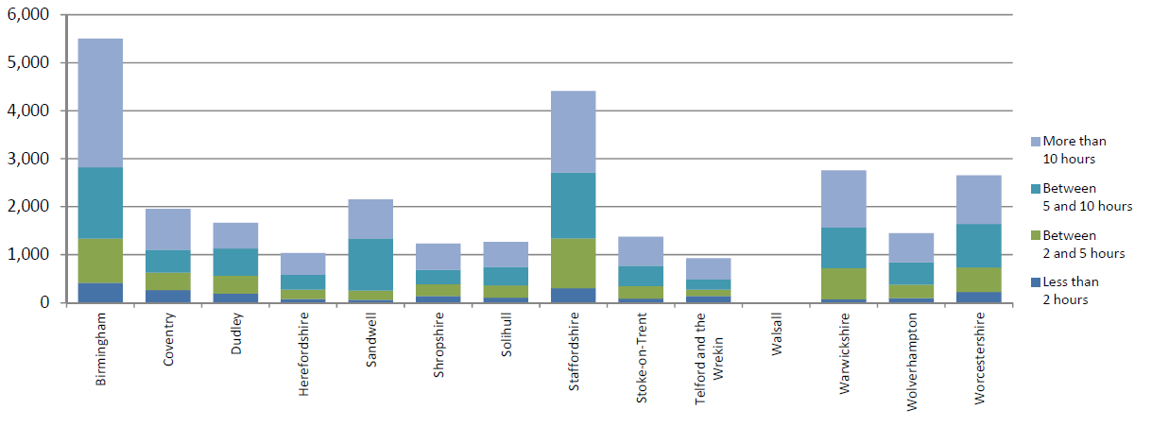
Source: RAP H1 – number of people in receipt of homecare on 31st March 2012 by the number of planned hours per week (The Information Centre for Health and Social Care)
Tracking reduction in average hours of homecare per person – Telecare can provide contribution

Slide 12
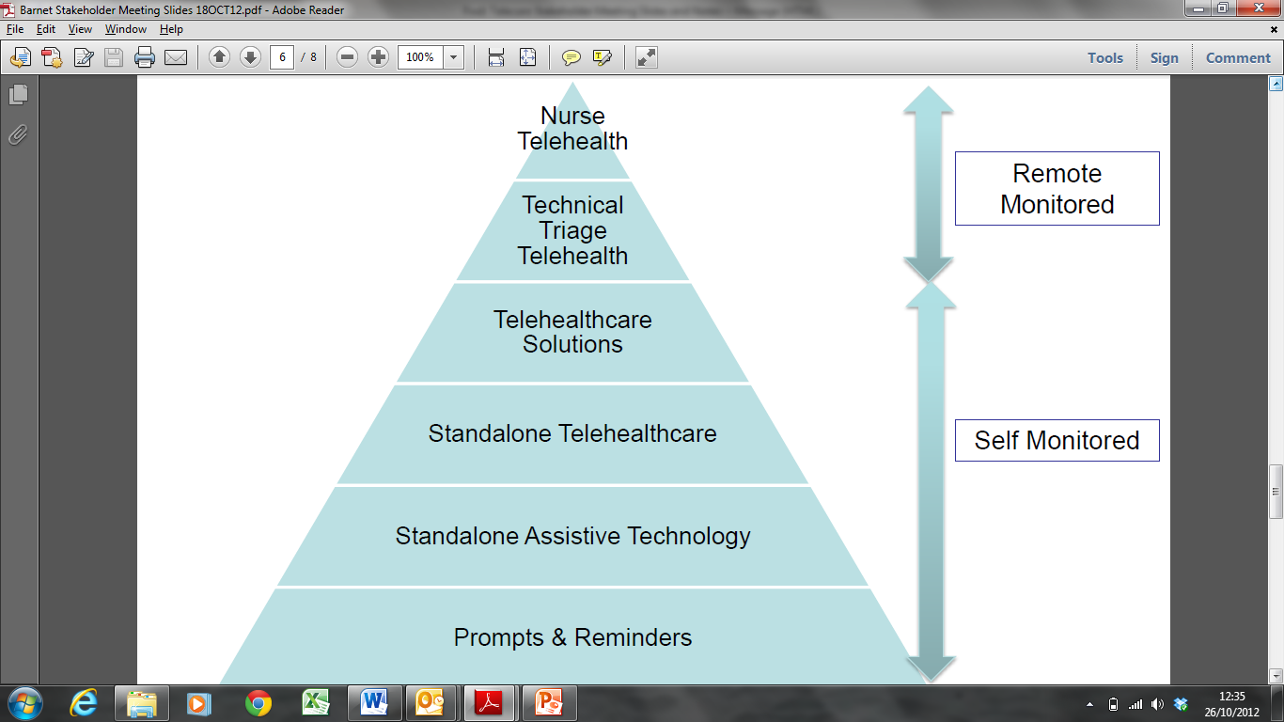
Technology at the heart of the customer journey through Social Care, Health & Housing & Telecare
Unless absolutely necessary patients should not sit at the top of the pyramid on long term remote monitoring
There should be a step up / step down process in place to encourage patients to self monitor so expensive equipment can be recycled
Greater use of standalone Telecare equipment should be use to assist prevention .

Slide 13
Telecare & Telehealth required Interventions
Telecare & Telehealth required Interventions
A&E
Social Worker access to Technology
Wards
Pill Dispenser
Discharge
Embed into home routine
Falls Detector
Wandering Alert
Prevention
Demonstrator Site
Carers and Family
Reablement
Outcomes measurement
Self-funder
Gadget Gateway
First Responder
FPOS Training
Vital Signs Checks
Lifting Service
Retail Premises
Self-Monitoring
The earlier the intervention, the better the outcome. Telecare and Telehealth can make a greater impact when introduced at the right time

Slide 14
Aspiring higher - hospital discharge, GP prescribing of Telecare, e-commerce – Position technology at the centre of choice and control
Embedding Telecare/AT promotion and adoption within care provider contracts and across health & care settings – e.g. introducing AT into Care Homes in Staffordshire / supporting Health staff in Dementia wards in Worcestershire
Awareness of and access to technology and demonstrations within GP surgeries, hospital foyers, pharmacies, libraries
Empowering citizens to self-serve through the provision of e-commerce functionality and retail presence
Prevention investment – partnership with high street retailers and engaging with the ‘sandwich generation’

Slide 15
Aspiring higher – bringing assisted living solutions to the every day person – Position technology at the centre of choice and control
Self funder can be defined as:
someone FACs eligible but paying in full after means test
anyone off the street who might not come near social care initially, but may then deplete their personal resources completely and present at point they are completely dependent
anyone looking for solutions for themselves or on behalf of others and wishing to self serve
97% of people searching online for care and support do so on behalf of someone else
Telecare is ever closer to the high street
B&Q, Apple stores, Lloyds Chemists
3 million lives success is dependent on retail/consumer interaction and mainstream society

Slide 16
Regional work
Generating further good practice and realising efficiencies across the region
5 project proposals for consideration
Medication management
Personal budgets and self funders
Increasing use of Telecare within LD services
Increasing use of Telecare within high cost placements
Telecare within Reablement / Hospital discharge

Slide 17
In Summary – recommended activities
Bringing down the cost of care packages using Telecare
Ask ‘Why not Telecare’ at every interaction with the service user
Reablement and Telecare hand in hand – from 1120 users receiving Telecare within Reablement in Hillingdon, only 1 person chose to have Telecare removed post Reablement
Focused reviewing team armed with Telecare expertise
Embedding technology as the default position
Awareness training for all – staff, providers, voluntary sector
Robust performance dashboard in place and visible for all
Evaluation is vital; build into benefits realisation model
Positioning technology at the heart of choice and control
Invest in marketing and awareness on the high street
Collaborate with GPs, Providers, Health, Fire, Police, Housing
Partner with industry and retail to make technology attractive to the ‘grey pound’

